Slide 1
Under Amsterdam
Minor Extended Reality (XR)
Welcome!
Team VRAholics
Notes:
Daniel

Slide 2
Index
Introduction
Client Original idea
Milestones
Final product
Conclusion
Team VRAholics
Notes:
Daniel

Slide 3
The Team
01
Creators of Under Amsterdam
Team VRAholics
Notes:
Quinn

Slide 4
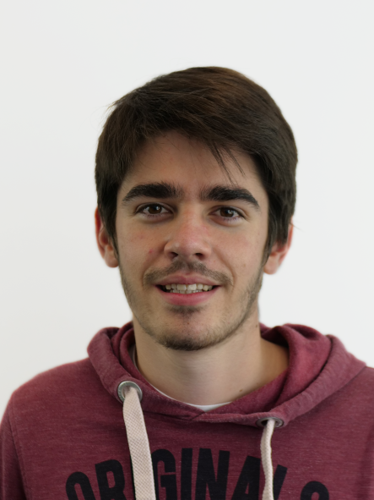
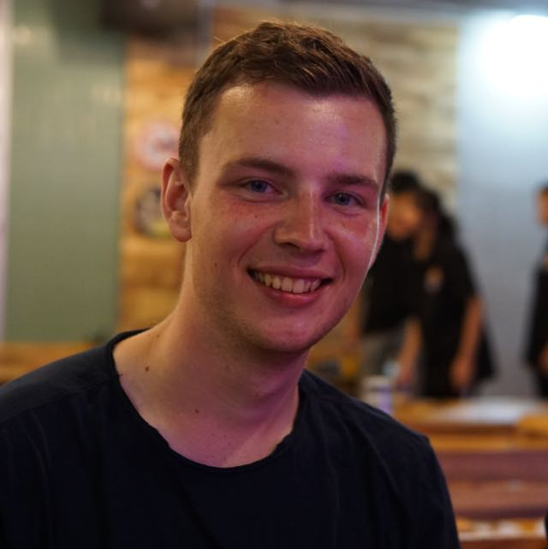
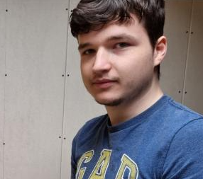
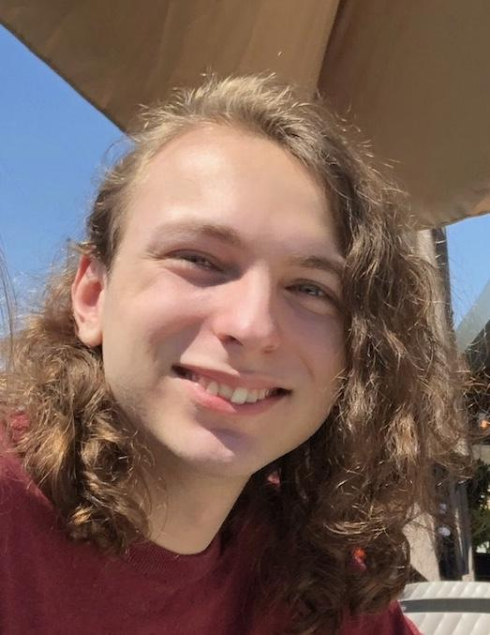
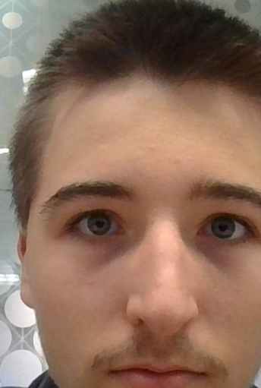
The Team
Luan - Computer science
Daniel - Aviation
Quinn - Game Developer
Adrien - Computer Science
Jeroen - Game Developer
Team VRAholics
Notes:
Quinn

Slide 5
Introduction
Multiplayer
Awareness
Puzzle game
Team VRAholics
Notes:
Quinn
Why

Slide 6
Client Original Idea
VR puzzle game
Connecting pipes
Come back and change them
Board game rules
Different companies
System based on least amount of pipes and time.
How did the game come to what it is today?
Team VRAholics
Notes:
Jeroen

Slide 7
Milestones
Sprint 1
Sprint 2
Sprint 3
Sprint 4
Sprint 5
Final
Concepting phase
Multiplayer build
Many functions and bugfixes
Multiple scenes
Rework of everything
Working game
Team VRAholics
Notes:
Jeroen

Slide 8
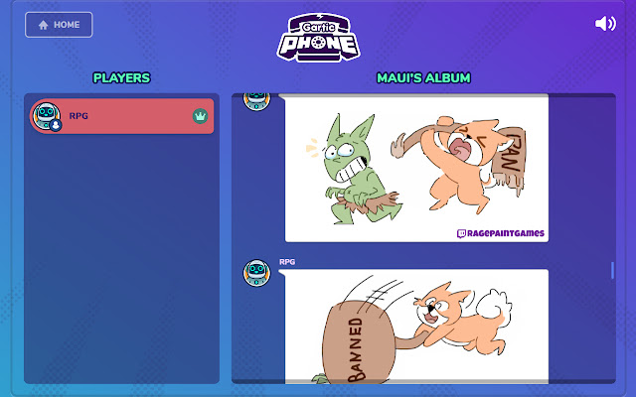
Sprint 1
Concepting phase
Rules
Cartoonish visual style
Multiplayer game
Pipe grid
Rotating company teams
Info watch
Dig site
Gartic phone
Team VRAholics
Notes:
Jeroen

Slide 9
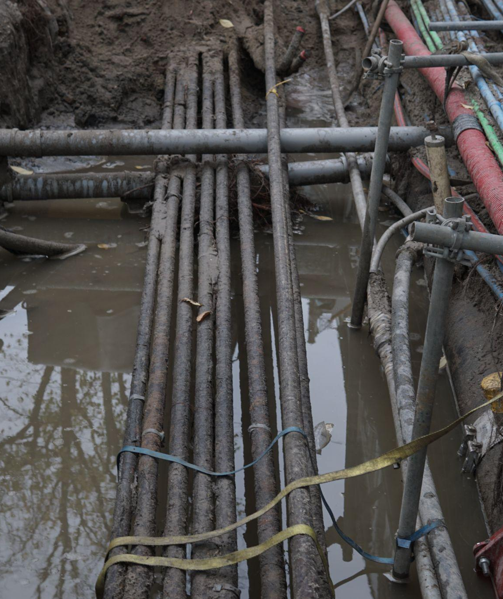
Getting the setting right
Doing research in the field to get the game correct.
Team VRAholics
Notes:
Jeroen

Slide 10
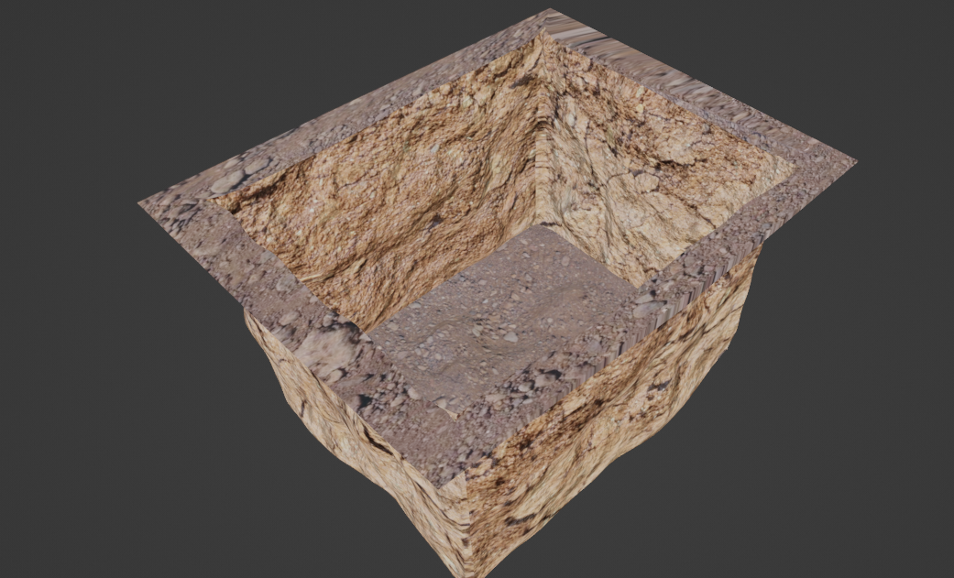
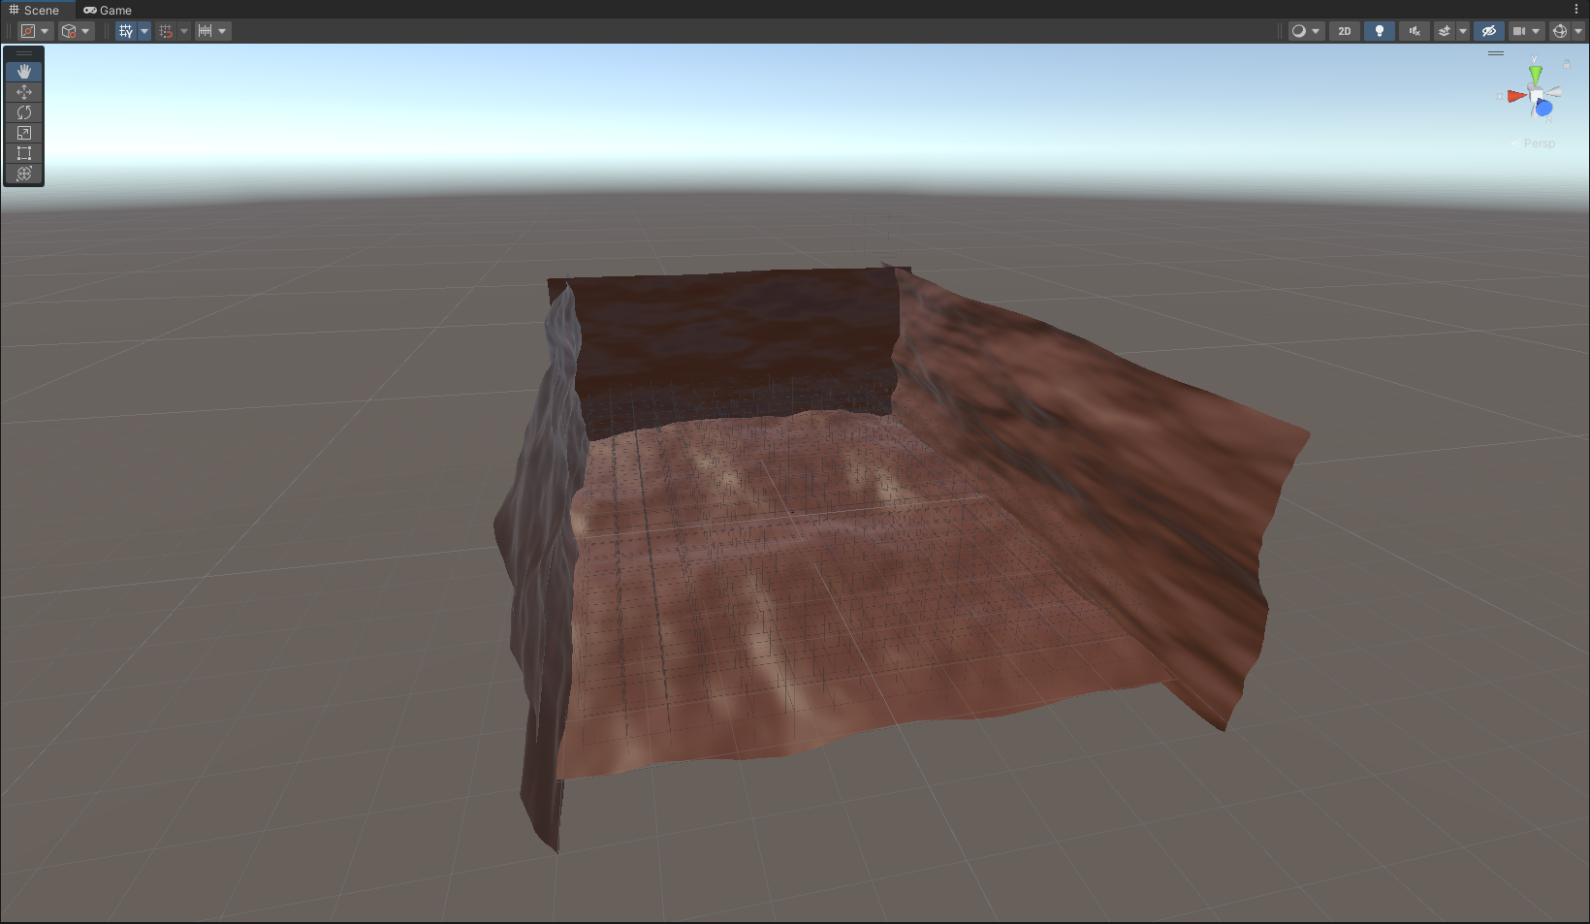
Sprint 2
Improved wrist watch
Auto connecting pipes
Field research
Basic multiplayer testing
Team VRAholics
Notes:
Adrien

Slide 11
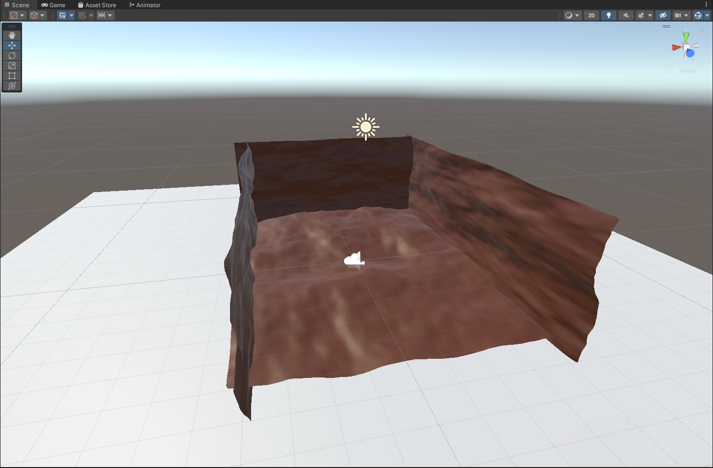
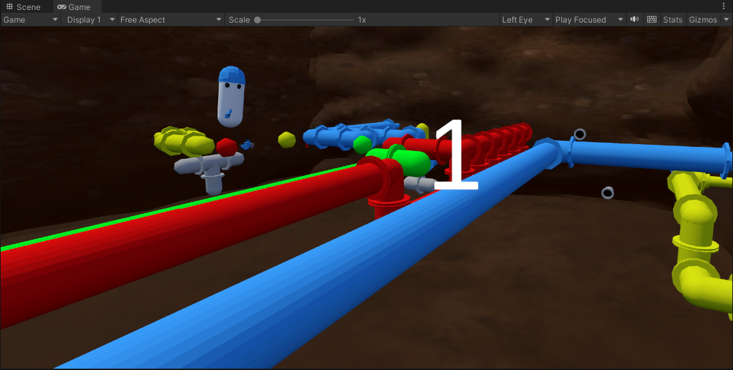
Sprint 3
Company system implemented (colored pipes)
Added sound
Performance improvements for Quest 1 (Pipe LOD)
First build/prototype ran on the Quest 1
Team VRAholics
Notes:
Luan

Slide 12

All was reworked
The concept had to be expanded to fit in a more immersive VR experience
Team VRAholics
Notes:
Luan

Slide 13
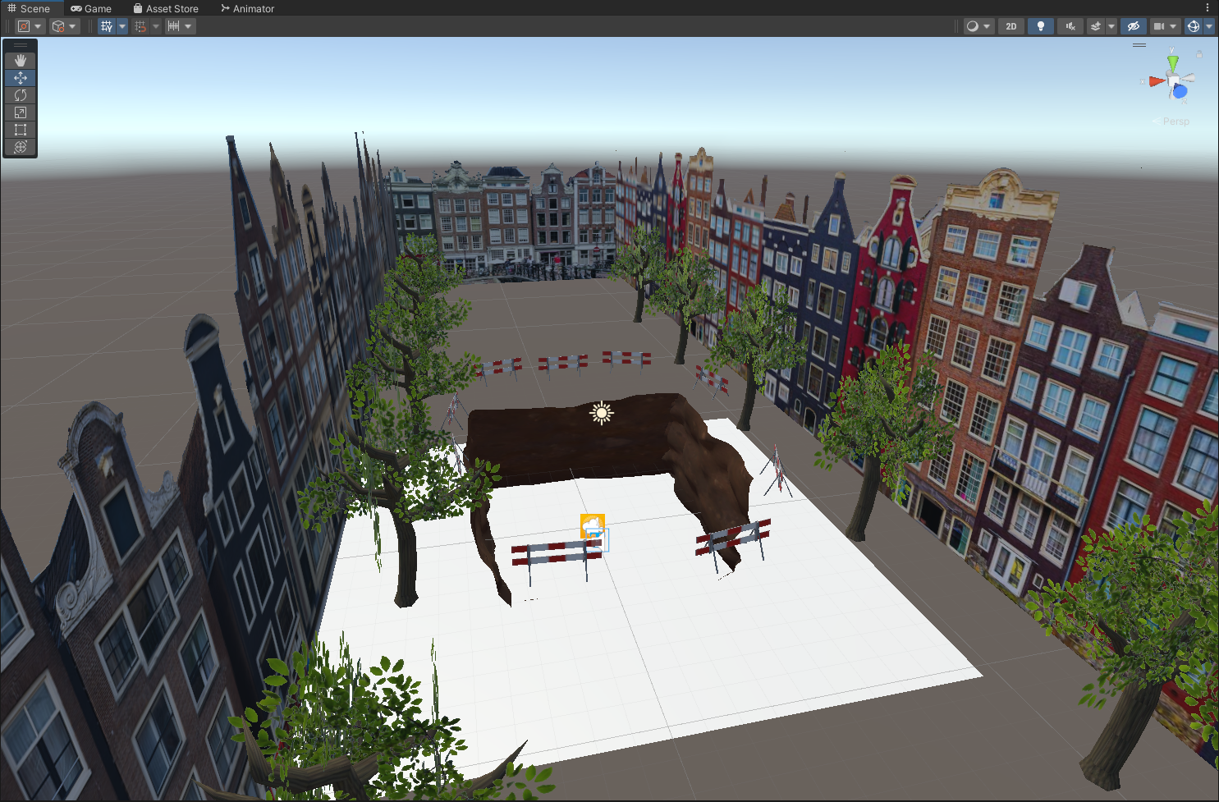
Sprint 4
Working lobby
Switchable scenes
Story
Keyboard
Voice chat
Team VRAholics
Notes:
Daniel

Slide 14
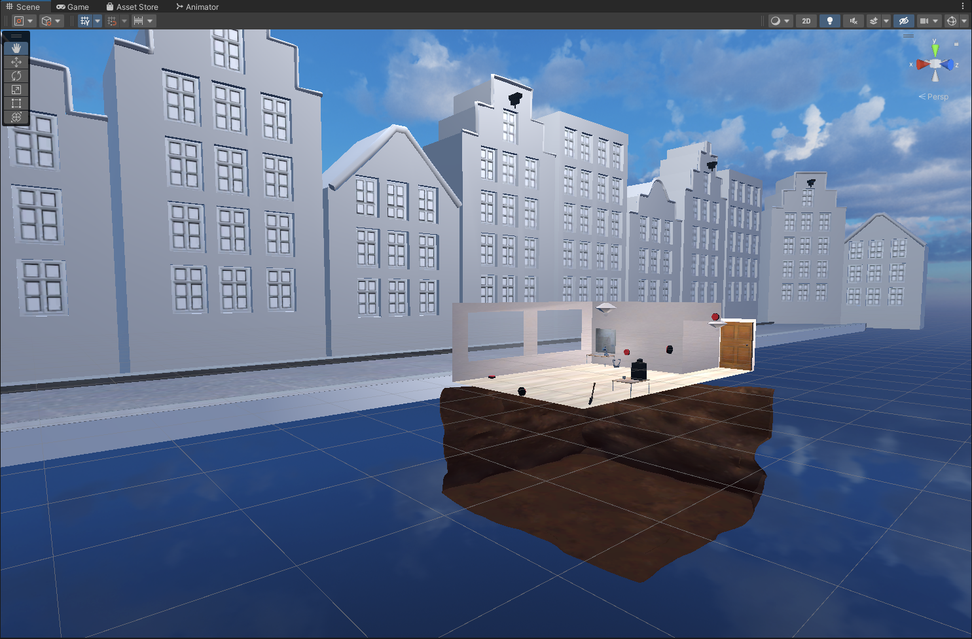
Sprint 4
Team VRAholics
Notes:
Daniel

Slide 15
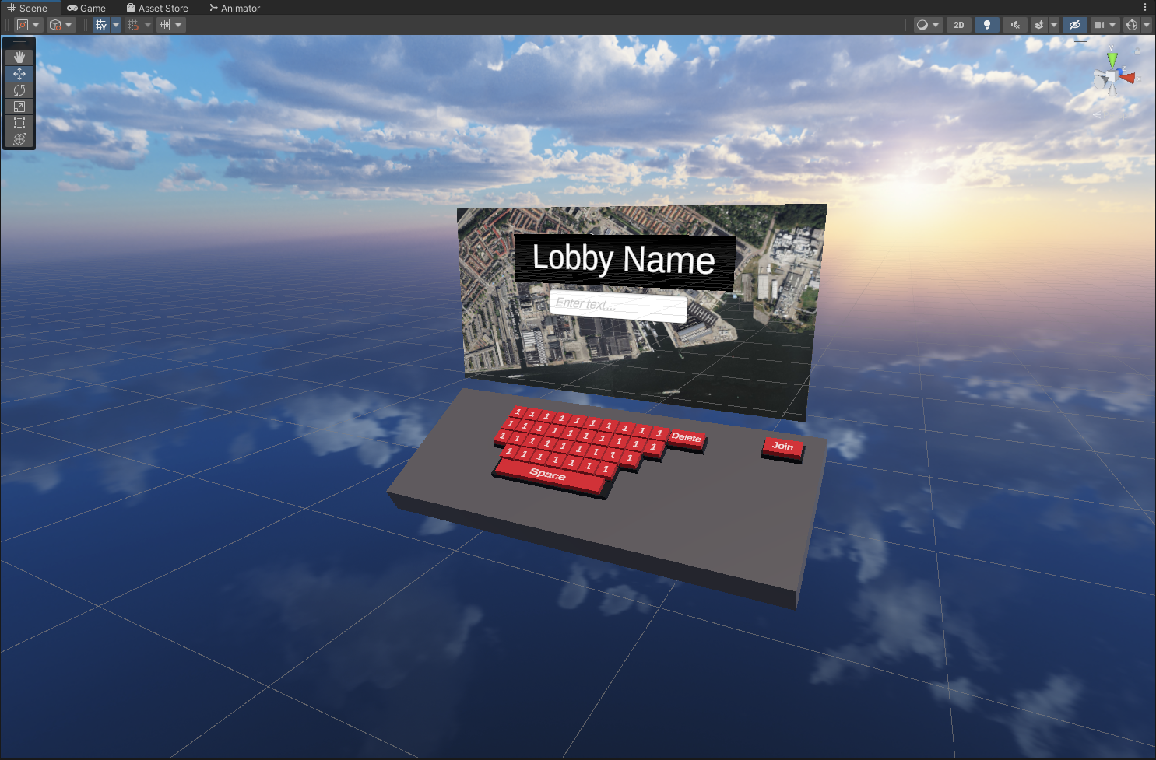
Sprint 4
Team VRAholics
Notes:
Daniel

Slide 16
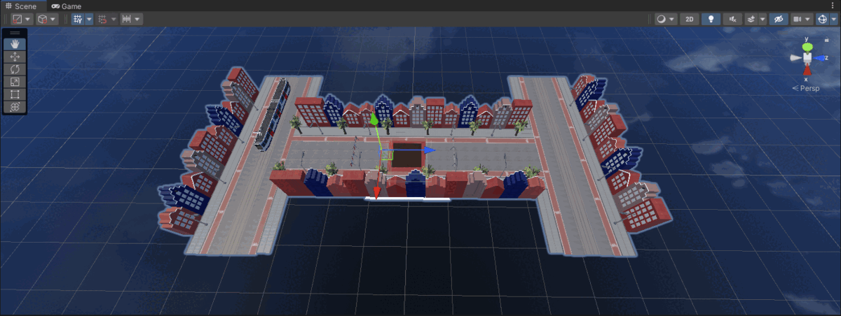
Sprint 5
Rework of lobby and game scene
3D buildings (immersion)
Player instructions
Volume slider
Difficulty setting
Video monitor
Podium
Team VRAholics
Notes:
Adrien

Slide 17
Three months
Can make a good VR game
Team VRAholics
Notes:
Adrien

Slide 18
Team VRAholics
Notes:
Adrien

Slide 19
Notes:
Adrien

Slide 20
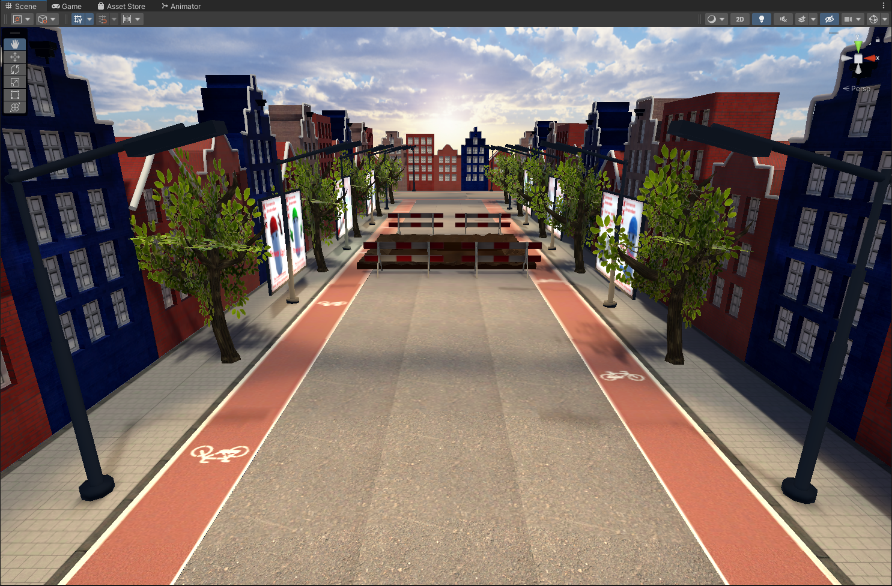
Five months
Can make a good VR game
Team VRAholics
Notes:
Adrien

Slide 21
“It just works”
—Todd Howard
Team VRAholics
Notes:
Jeroen

Slide 22
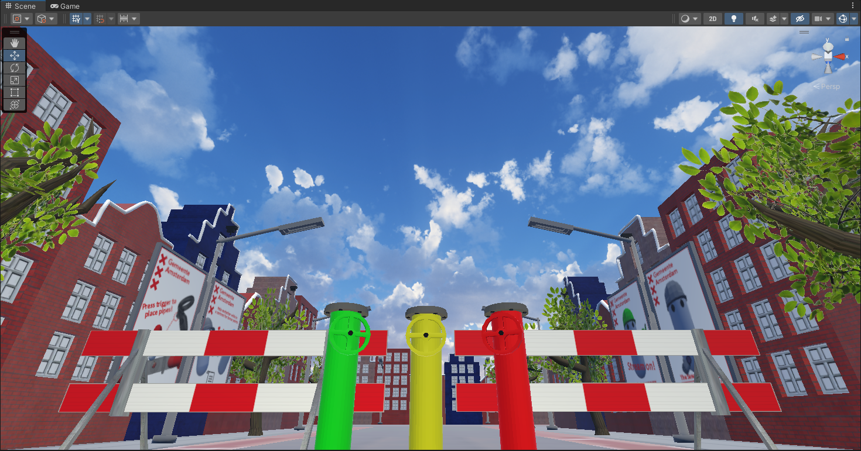
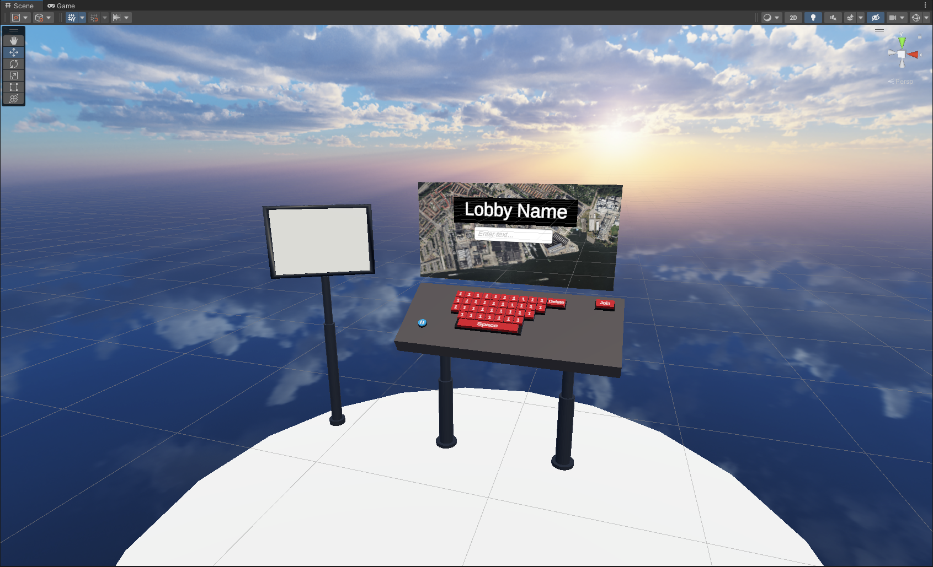
Final product
Solid gameplay loop
Scoreboard
Points system
Awareness
Team VRAholics
Notes:
Jeroen

Slide 23
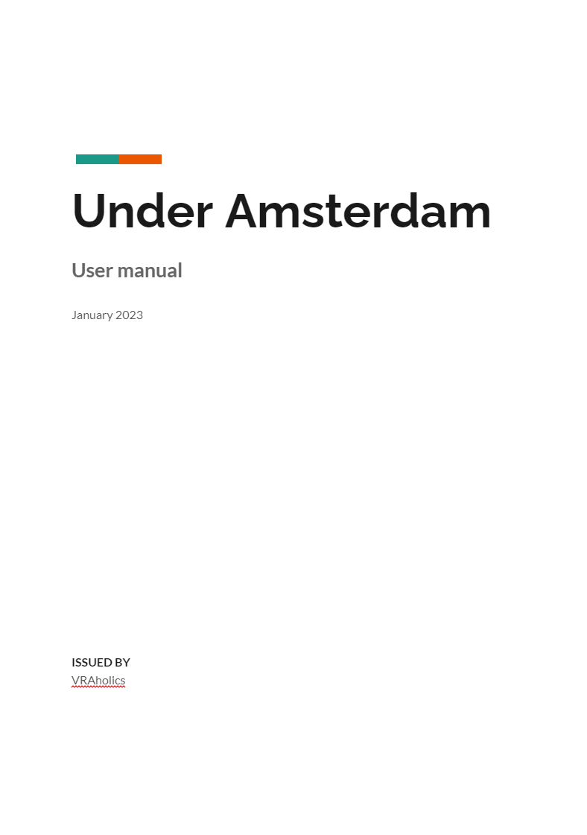
Conclusion
UnderAmsterdam
User manual
Technical manual
Team VRAholics
Notes:
Quinn

Slide 24
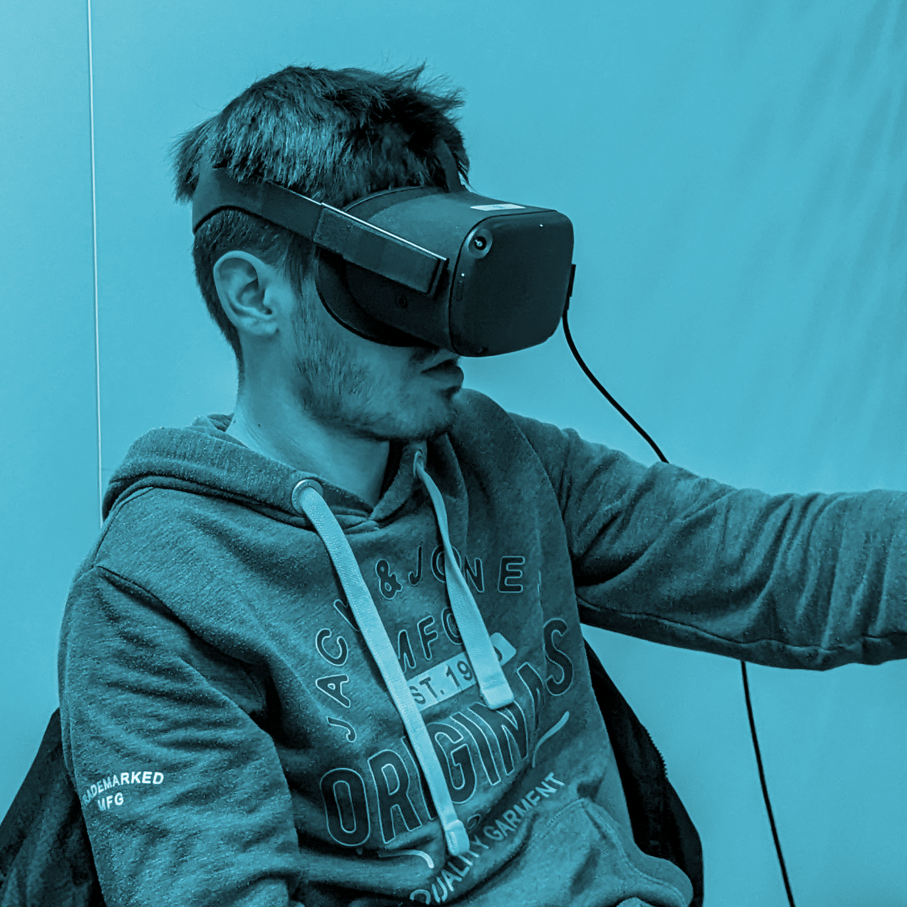
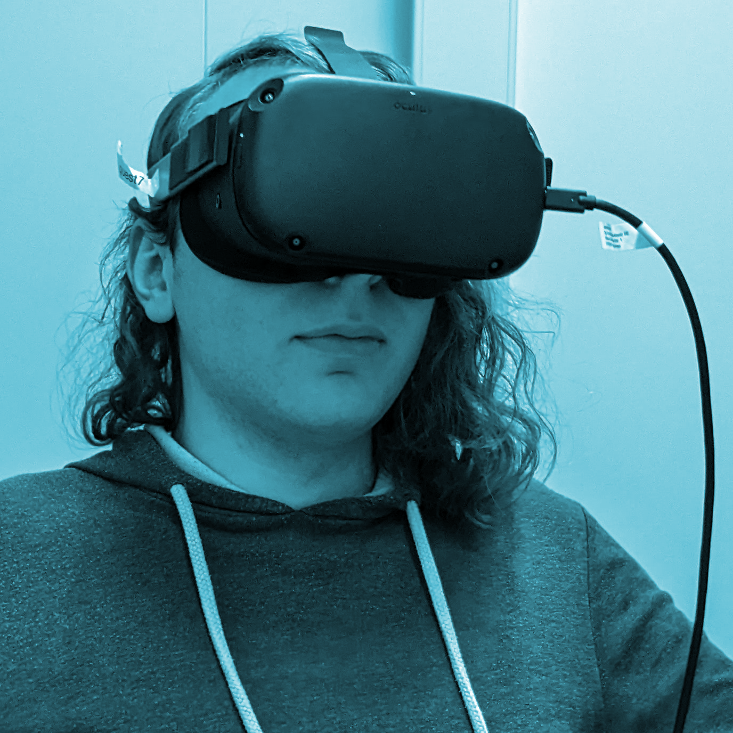
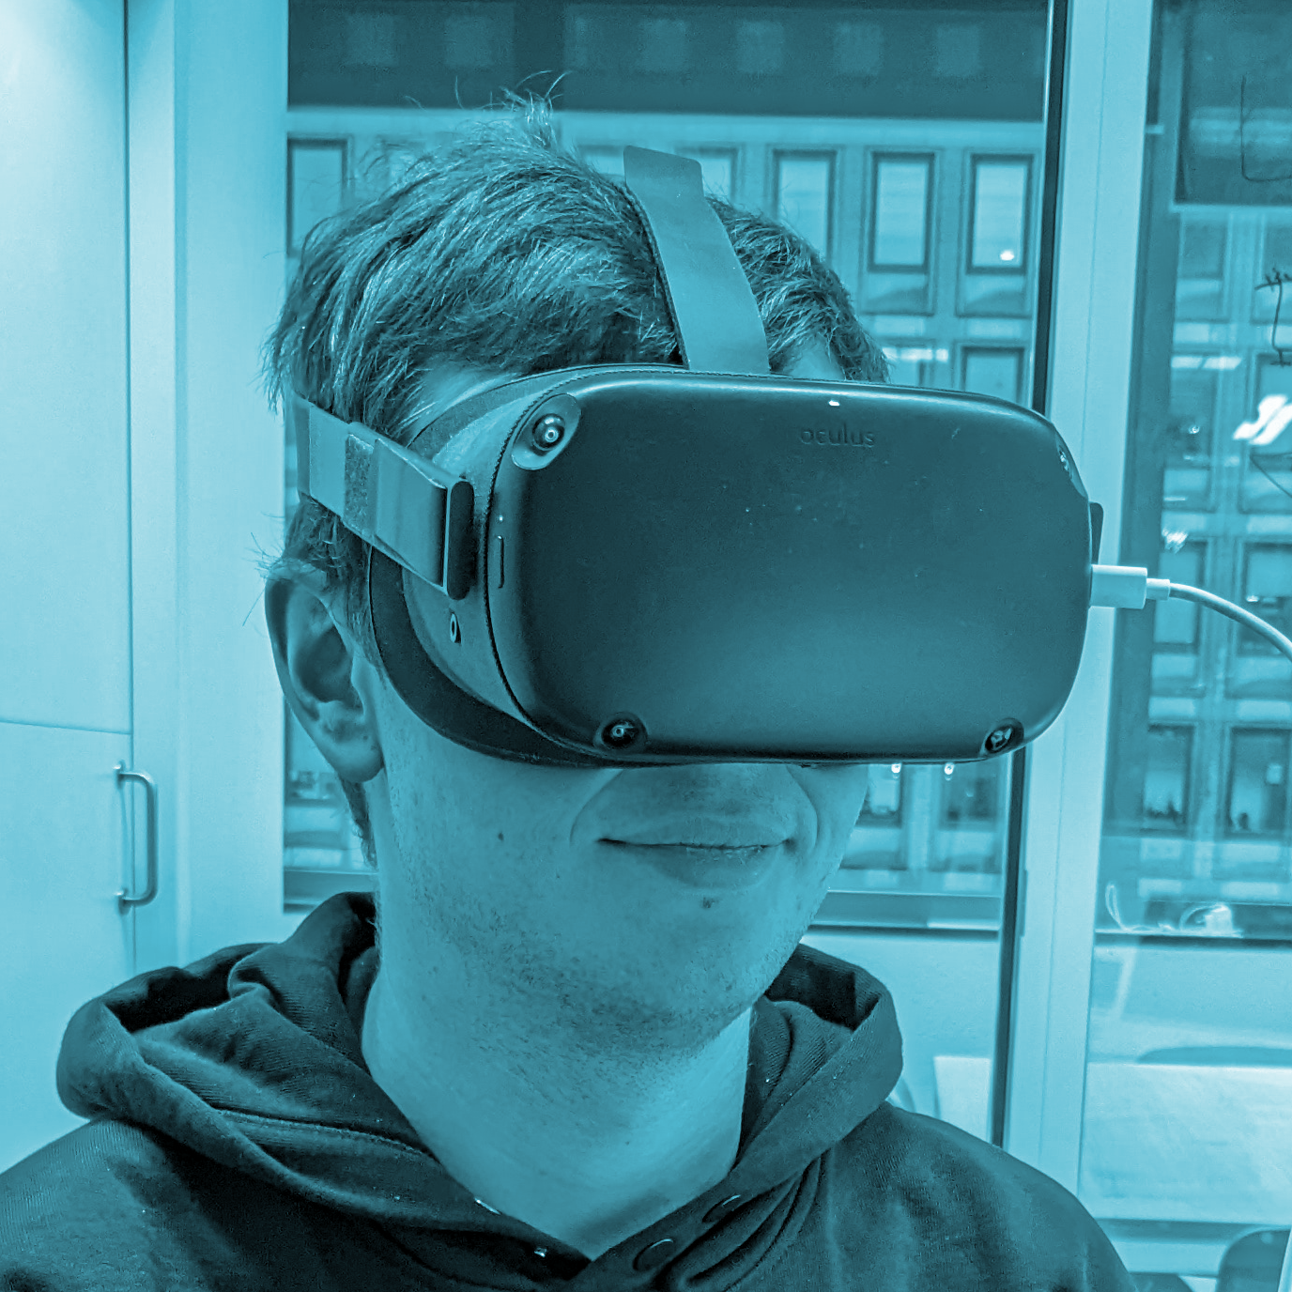
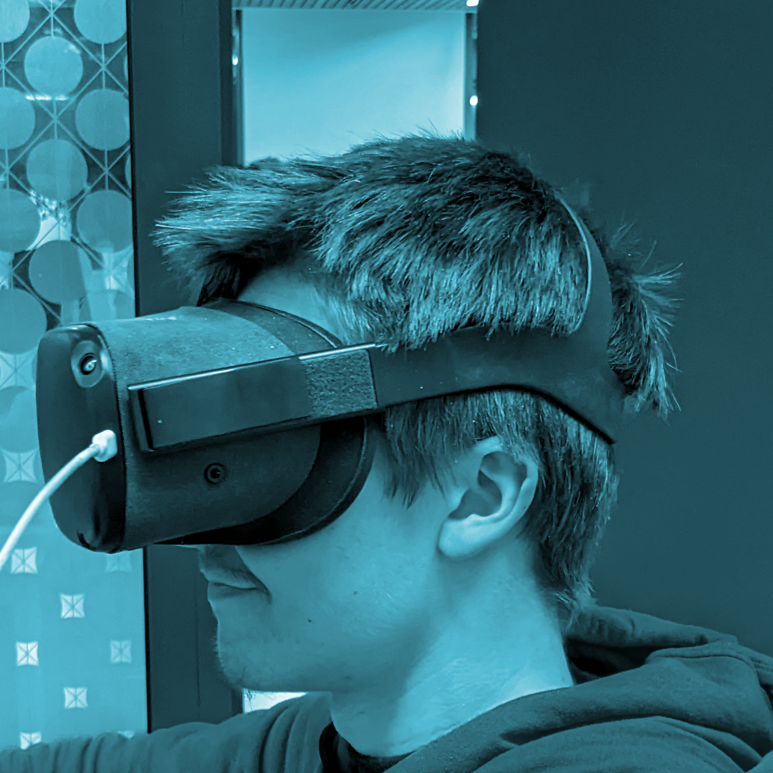
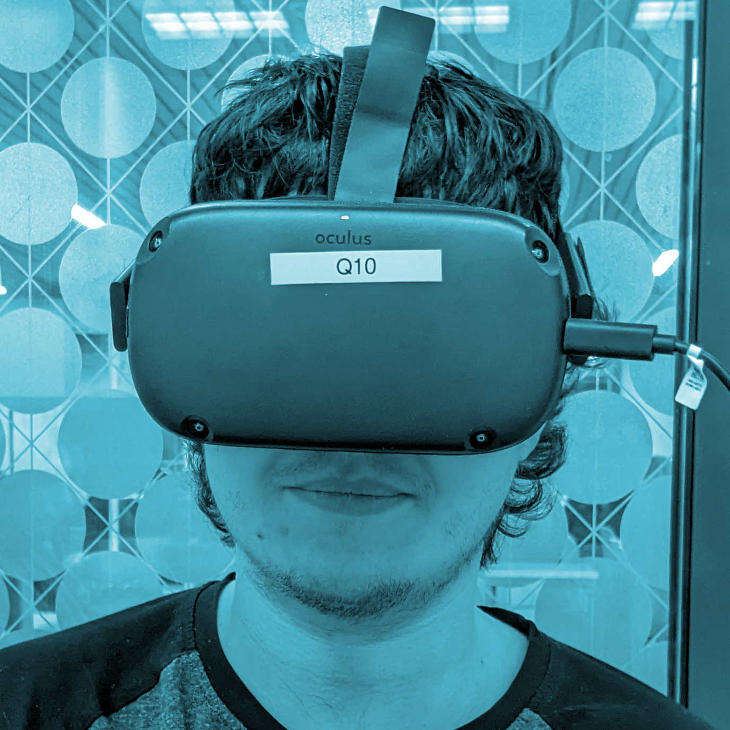
Thank you for participating with us!
Team VRAholics

